Slide 1
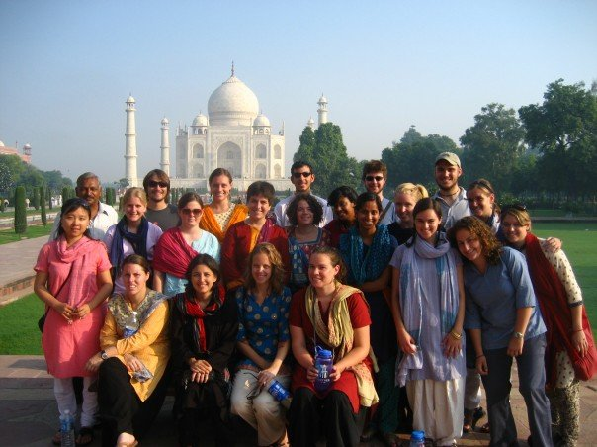
The New York State Independent College Consortium For Study in India (NYSICCSI)

Slide 2
Program History
Founded in 1989, the program in India provides a rigorous and challenging academic and cultural program in India. The program draws students from four upstate New York liberal arts colleges:
Colgate University
Hamilton College
Hobart & William Smith Colleges
St. Lawrence University
Over the course of the term, students live in 4 major cities in northern India: Delhi, Mussoorie, Jaipur, and Varanasi. A Faculty Director from one of the member colleges designs and facilitates the semester-long program.

Slide 3
Curriculum and Credit
Students Earn Credits for the Following:
Hindi
Reading, writing, and conversational skills.
Historical India
• History/Humanities: The culture and history of India prior to independence in 1947.
Contemporary India
Anthropology/Social Sciences: Society, politics and economy of contemporary India.
Independent Field work Project
Designed in consultation with the home-campus faculty representative and, often, with the student’s advisor early in the spring semester. The student does preparatory reading and library research in the spring and summer prior to their stay in India, and completes the project in the fall when the student takes advantage of the resources in India.
Students earn a full term’s credit from their home campus upon successful completion of the India Program. Credits earned on the program are considered resident credits and grade are averaged in the student’s cumulative GPA.

Slide 4
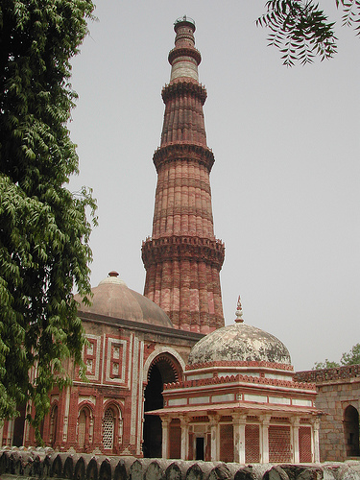
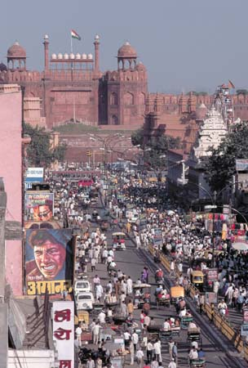
Program Structure & Setting
The Program begins in the New Delhi, India’s capitol.
A program orientation includes practical advice on
staying healthy and navigating streets, as well as visits
to the Qutub Minar and the Red Fort.

Slide 5
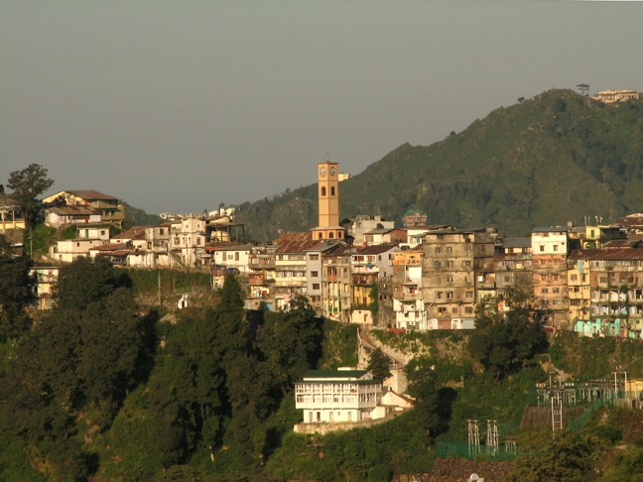
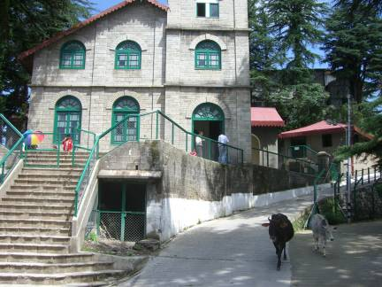
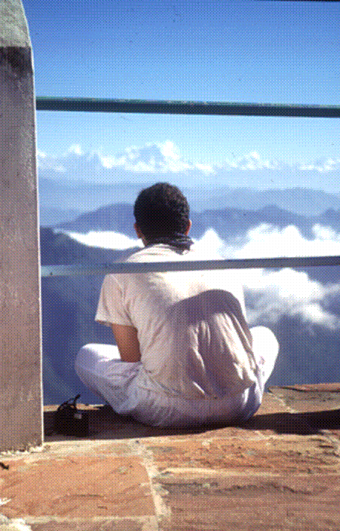
Program Structure & Setting
Students travel north from New Delhi to Mussoorie, a hill
station located in the foothills of the Himalayas. Students
begin Hindi at the Landour Language School, starting with
the devanagari script and learn about field methods for their
independent research project.

Slide 6
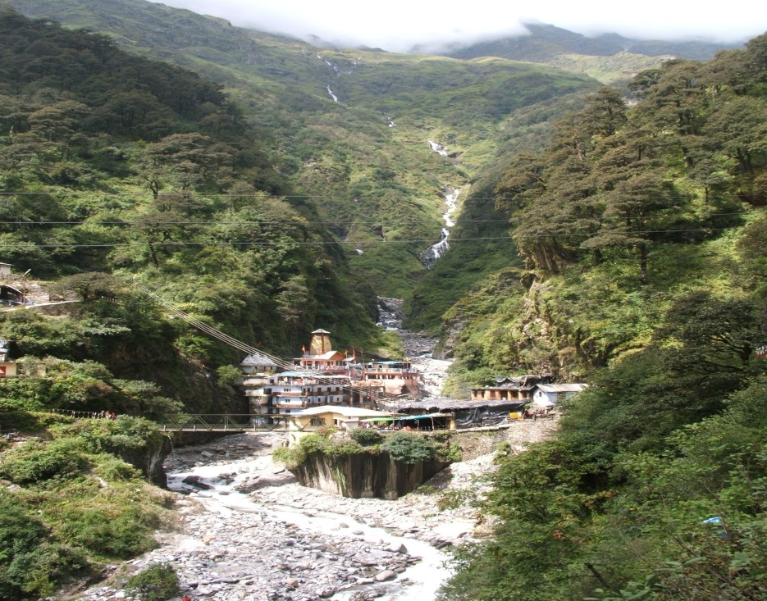
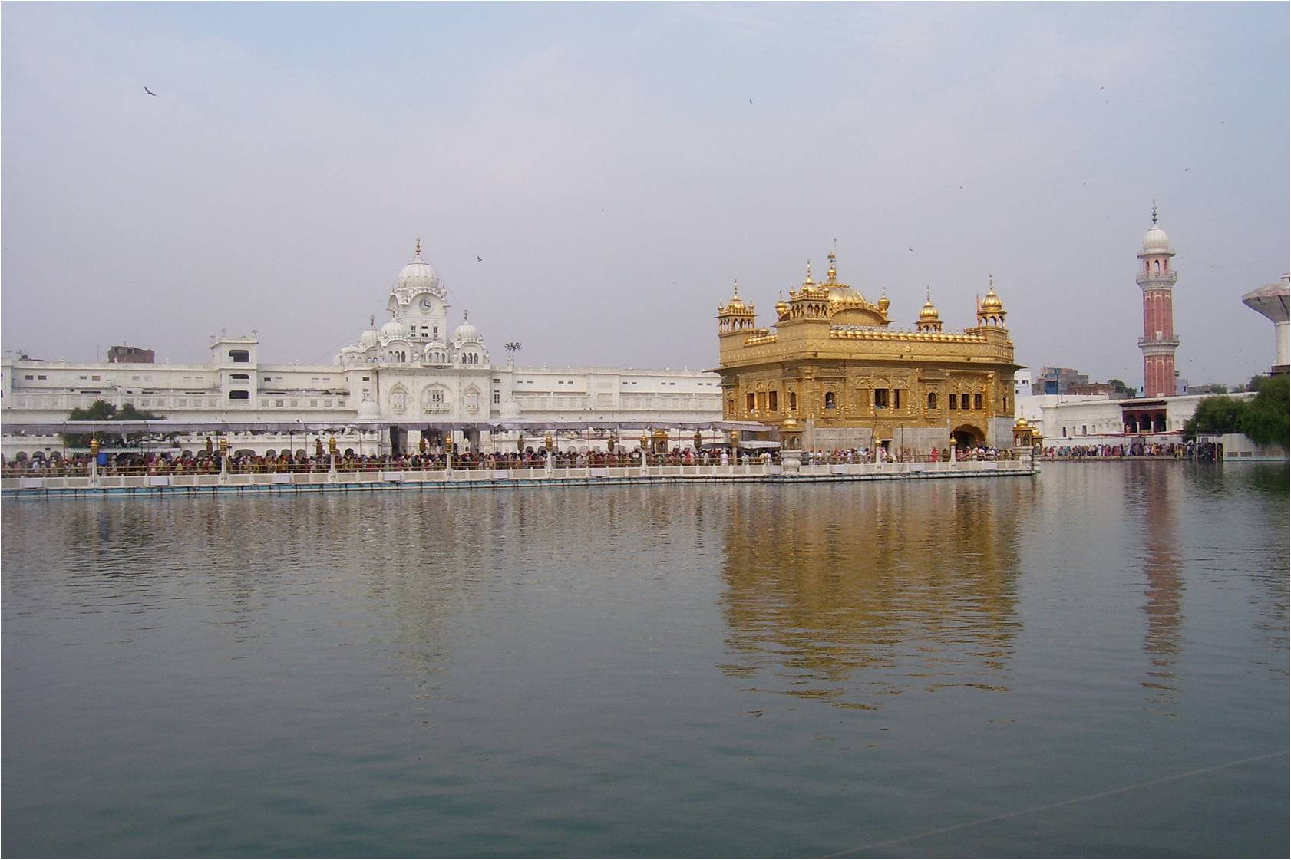
Program Structure & Setting
From Mussoorie the Program makes field trips to an
organic farm, to an ancient pilgrimage site at the source
of the Yamuna River, and to the holiest place for the
Sikh faith, the Golden Temple, Amritsar.

Slide 7
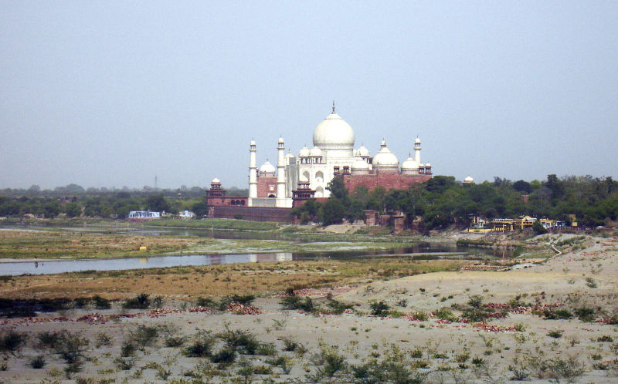
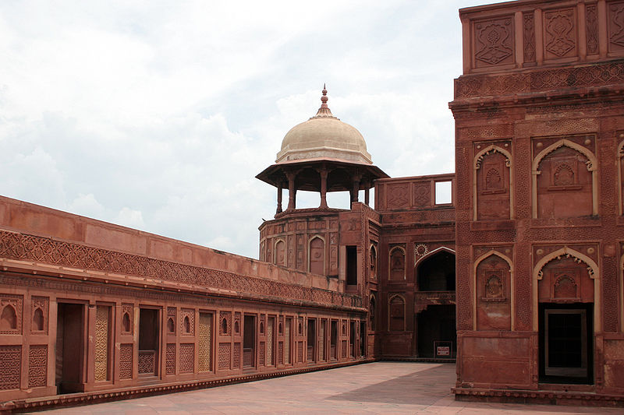
Program Structure & Setting
Students study the Mughal empire and its imperial
cities, including Fatehpur Sikri, Shahjahanabad, and
Agra to see the Taj Mahal and well as the Agra Fort.

Slide 8
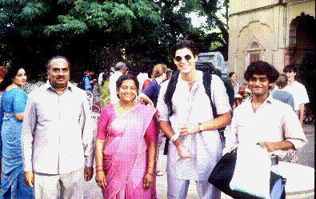
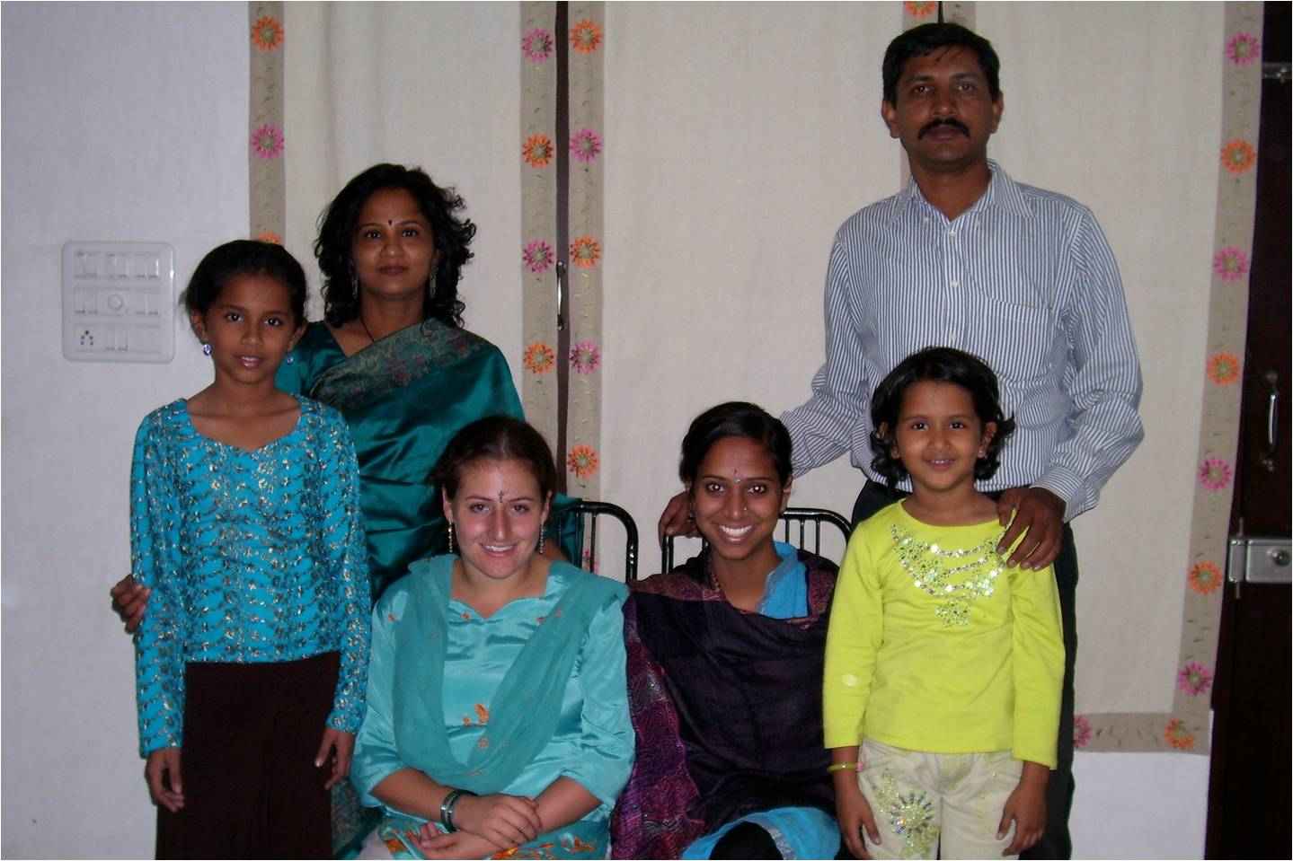
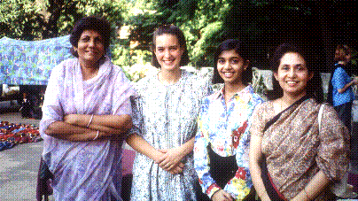
Program Structure & Setting
In Jaipur, capitol of the desert province Rajasthan, students
are assigned to a home-stay family. Not only are students
exposed to ordinary family life in India, they participate
in religious festivals, including Dusserha and Divali, with
their family.

Slide 9
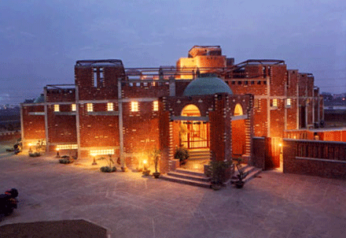
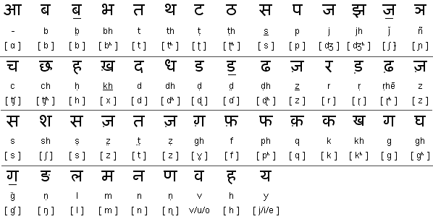
Program Structure & Setting
In Jaipur, students continue intensive Hindi instruction at
the American Institute of Indian Studies (AIIS). Building
upon their work in Mussoorie, students practice their Hindi
With their homestay families and as they explore Jaipur’s
magnificent cultural institutions.

Slide 10
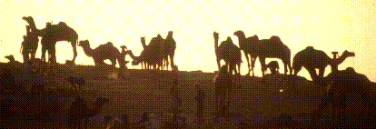
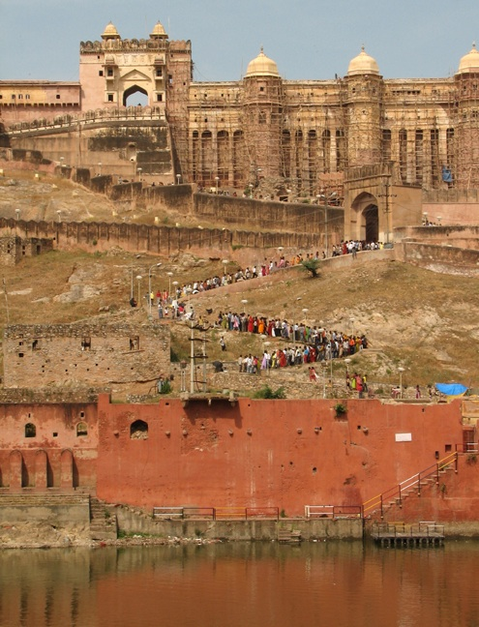
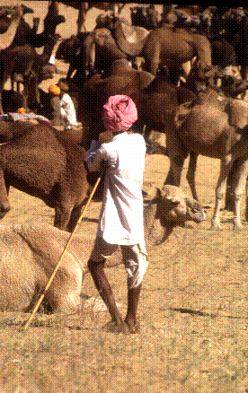
Program Structure & Setting
In Jaipur, students focus on contemporary society with
lectures in literature, religion, education, caste, and
communalism. Students have advisors chosen to facilitate
their independent fieldwork projects.

Slide 11
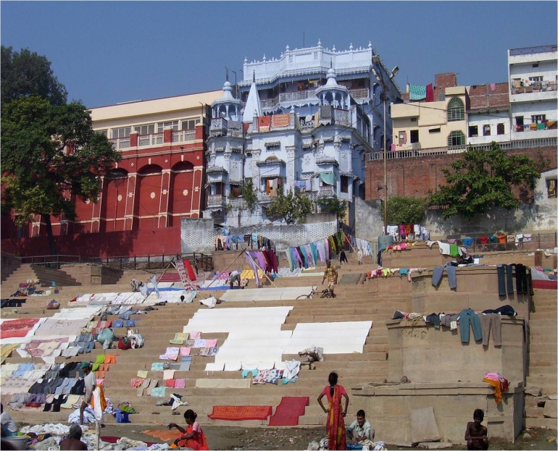
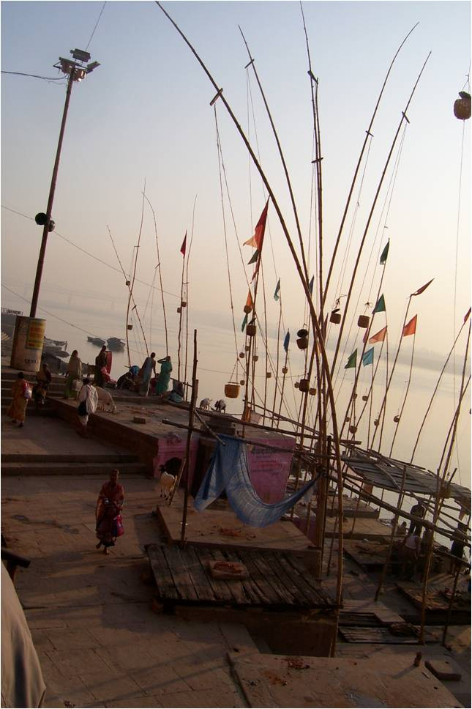
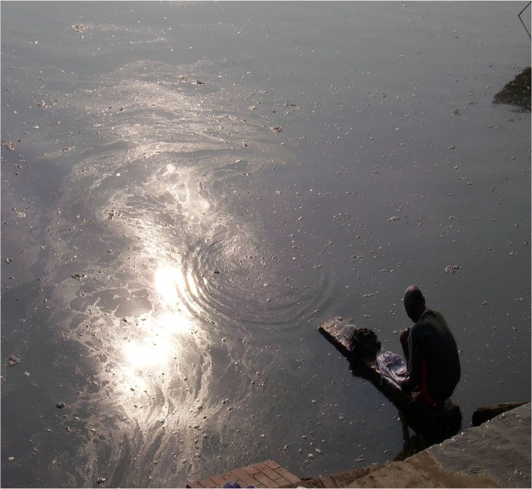
Program Structure and Setting
From Jaipur students travel to Varanasi (Banaras), one of the
most important places of pilgrimage for Hindus. On the
banks of the Ganges, students study Hinduism both
historically and in contemporary practice. They learn also
about the vibrant environmental movement in this holy city.
environental movement in this holy city.

Slide 12
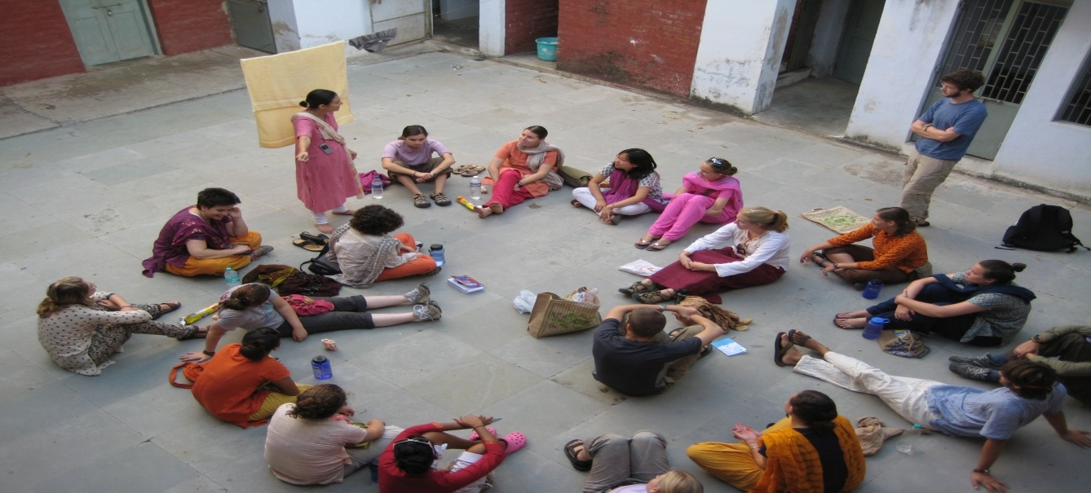
Program Structure & Setting
The Program concludes in Delhi, with time for
additional fieldwork and a formal presentation of
independent fieldwork projects. It is also a time to
reflect upon individual and group experiences.

Slide 13
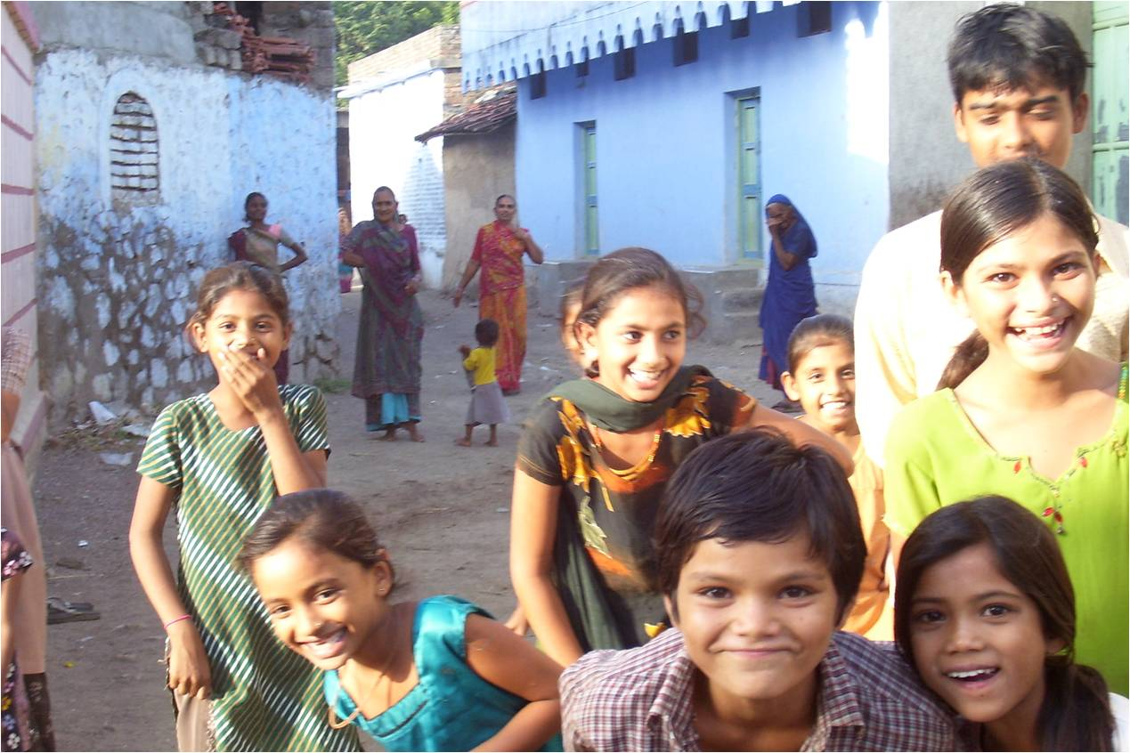
Thank you for considering the NYSICCSI Program. We hope to see you in India.

